Slide 1
9.15

Slide 2
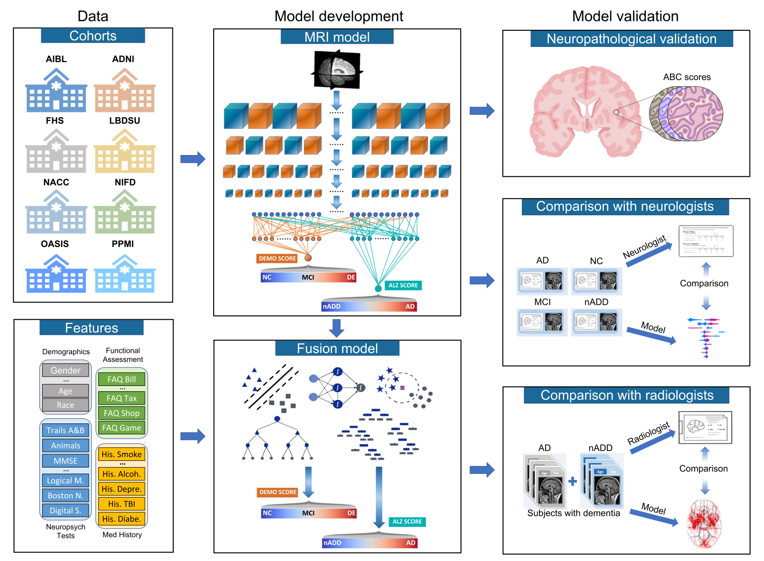

Slide 3
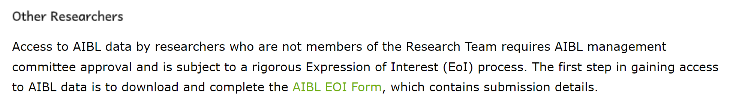
AIBL

Slide 4


Slide 5
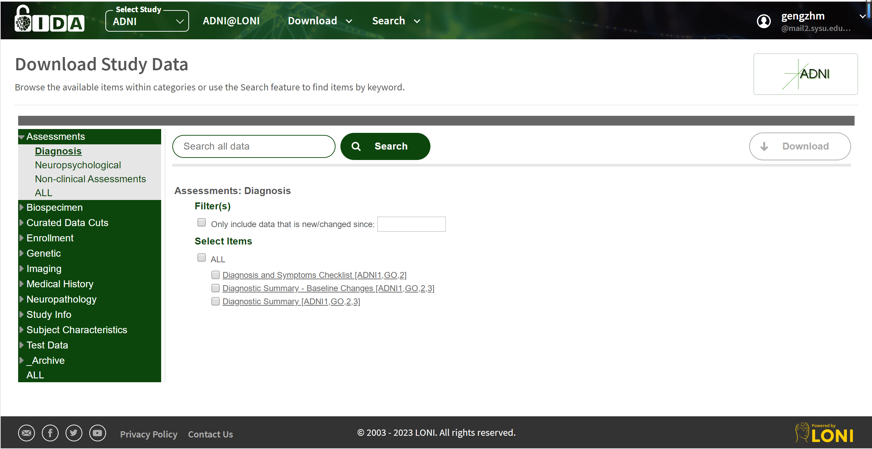
ADNI

Slide 6
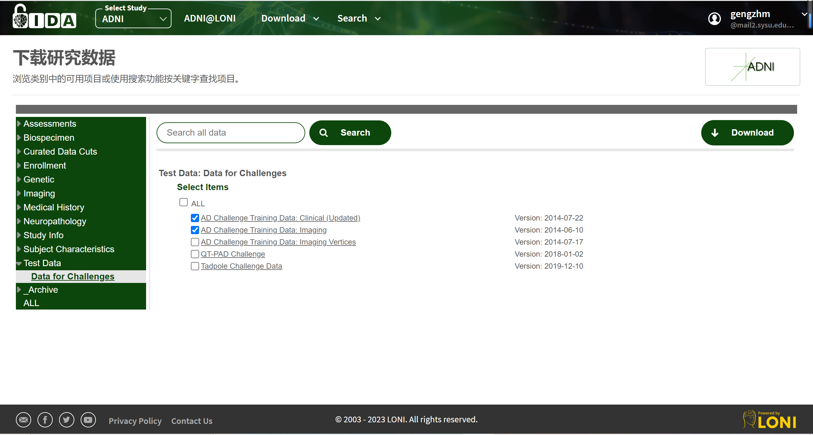

Slide 7
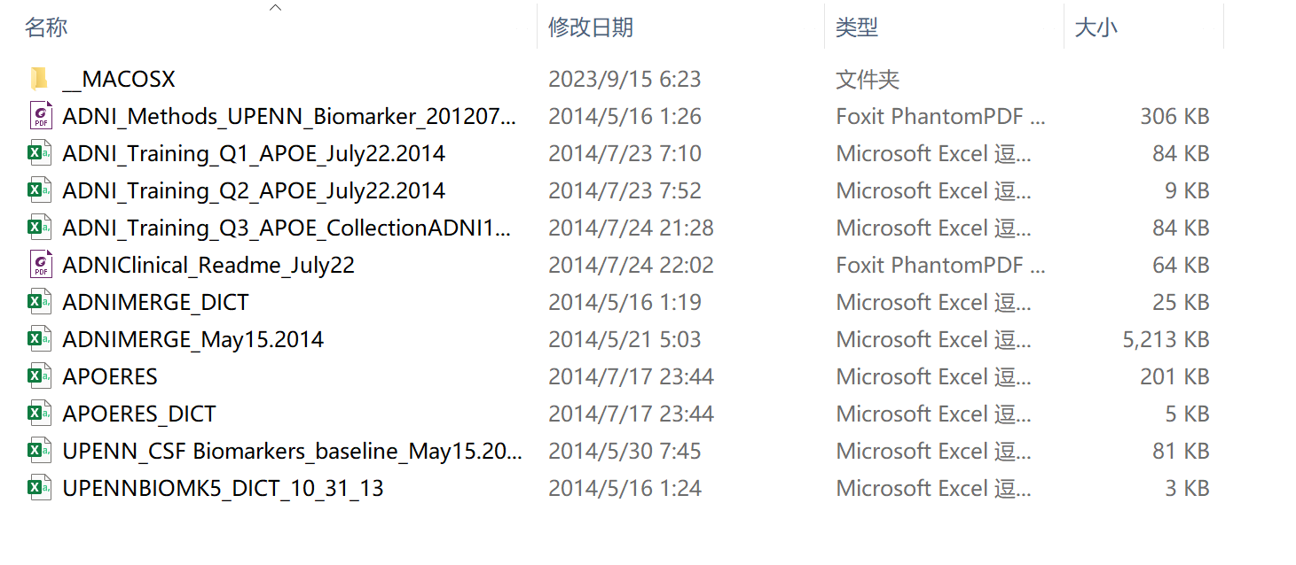
AD Challenge Training Data: Clinical (Updated)

Slide 8
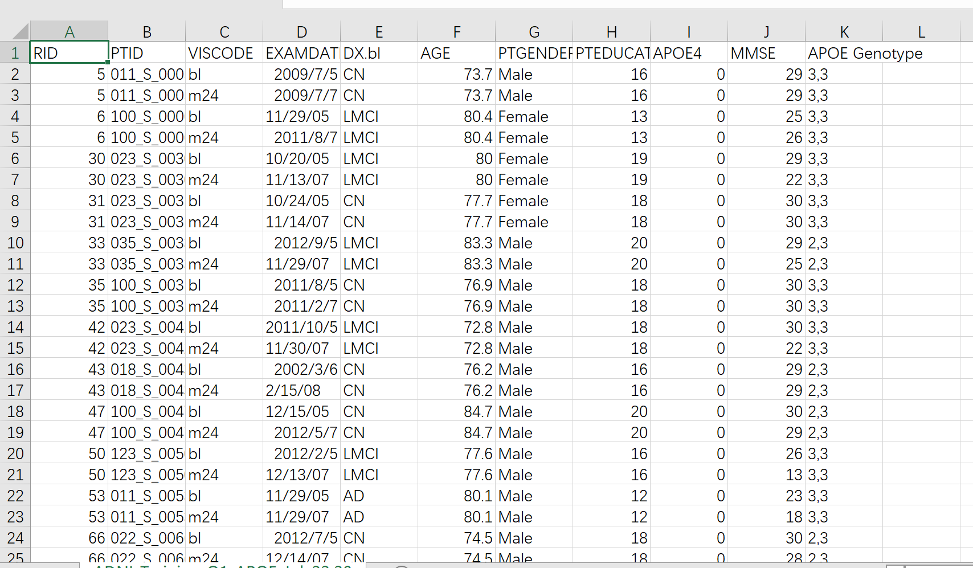
ADNI_Training_Q1_APOE_July22.2014

Slide 9
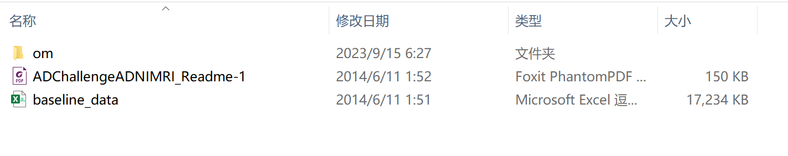
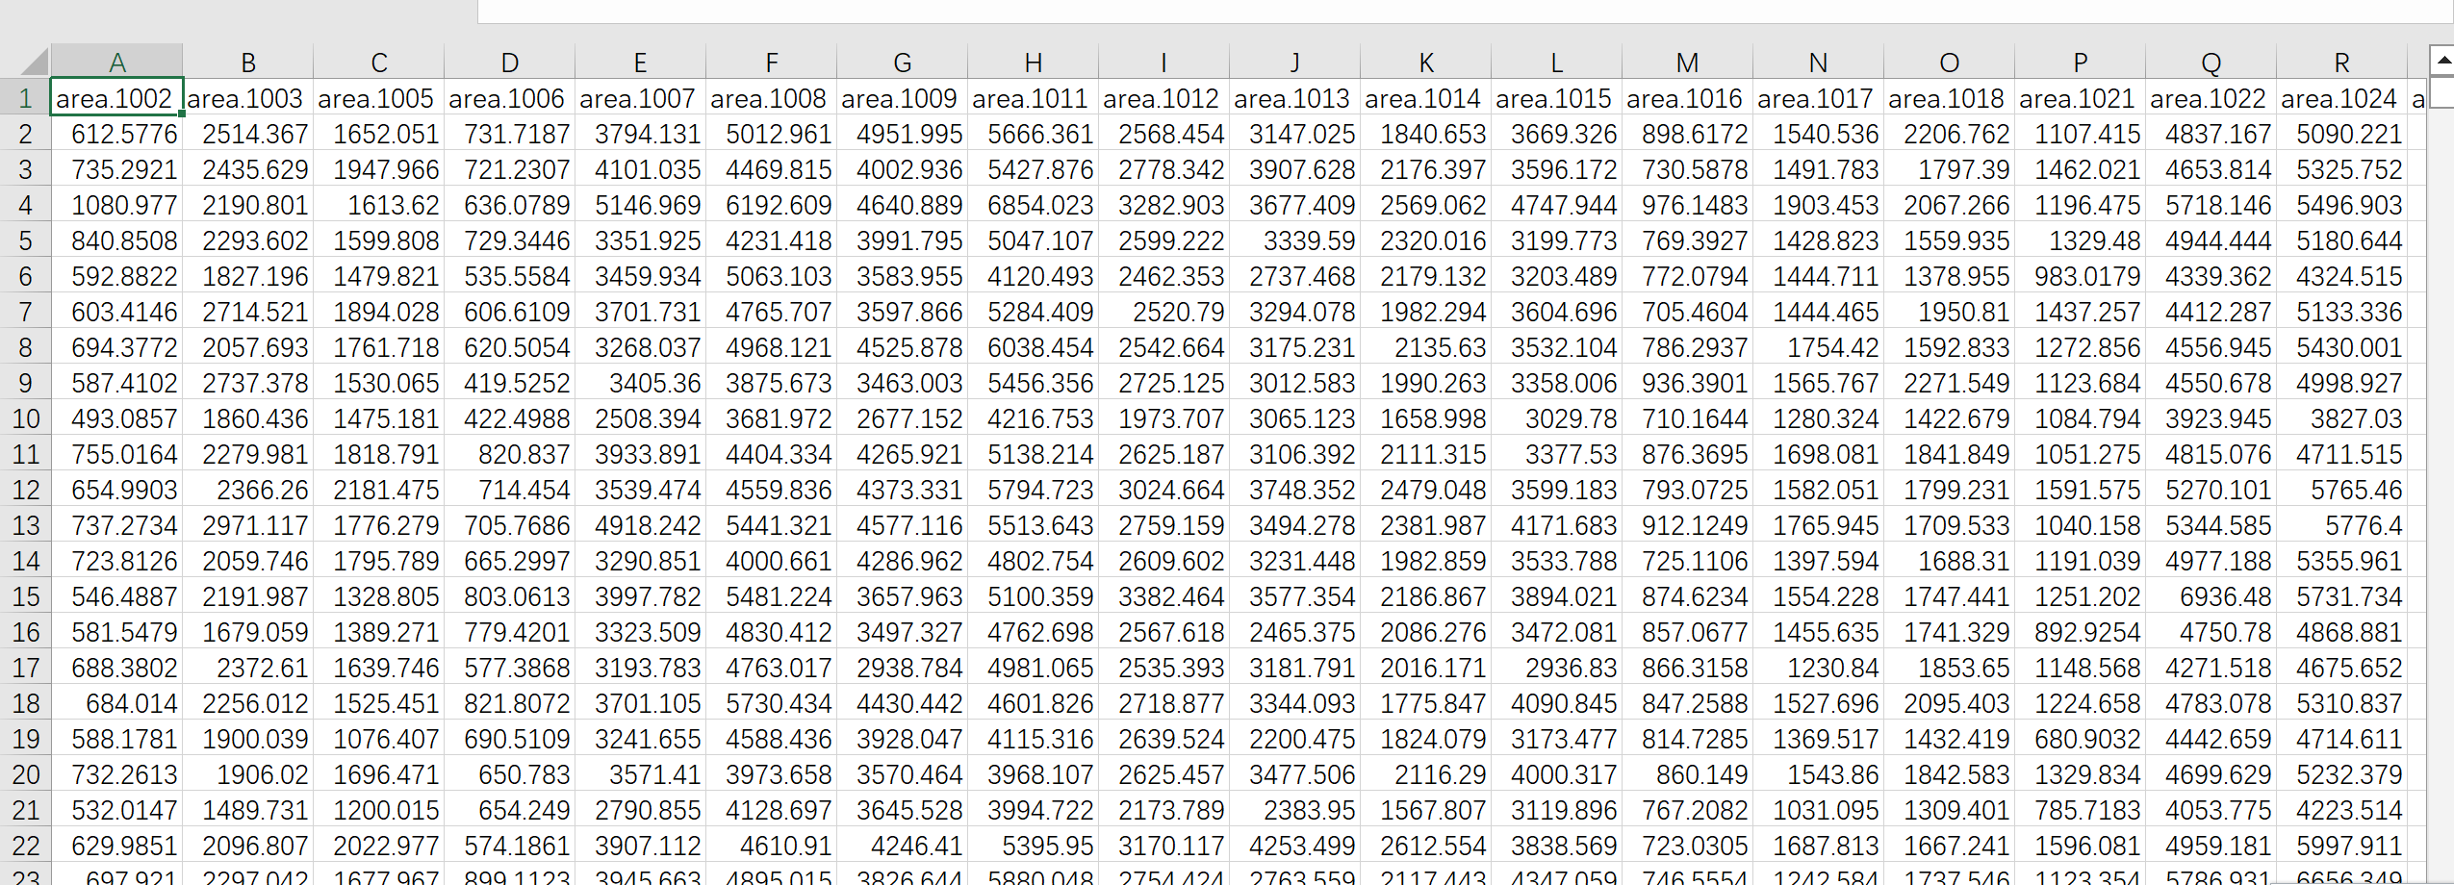
AD1ChallengeImagingFiles

Slide 10
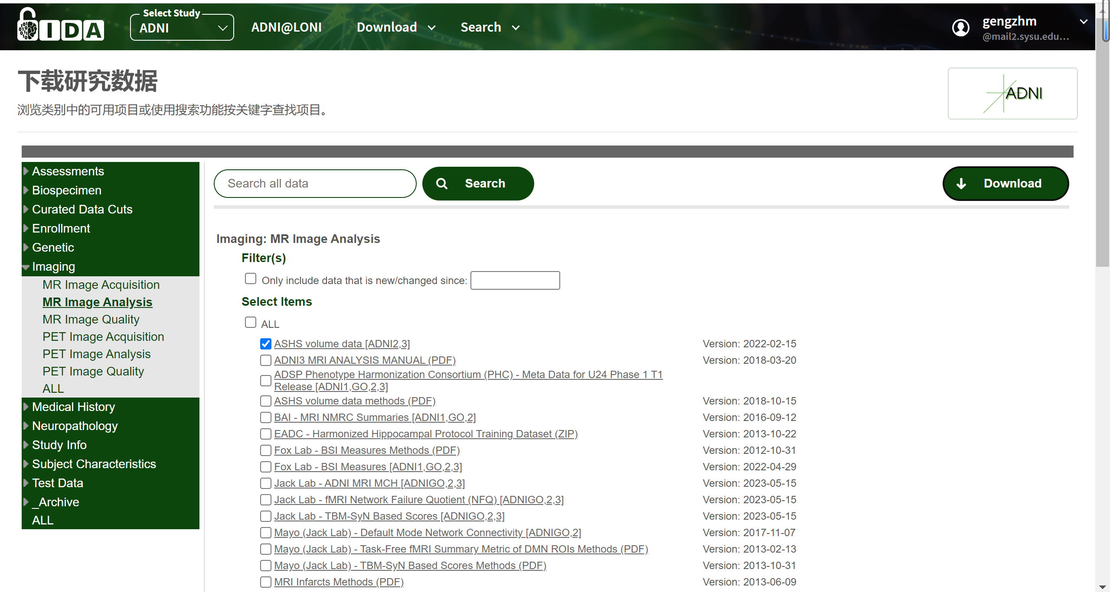

Slide 11
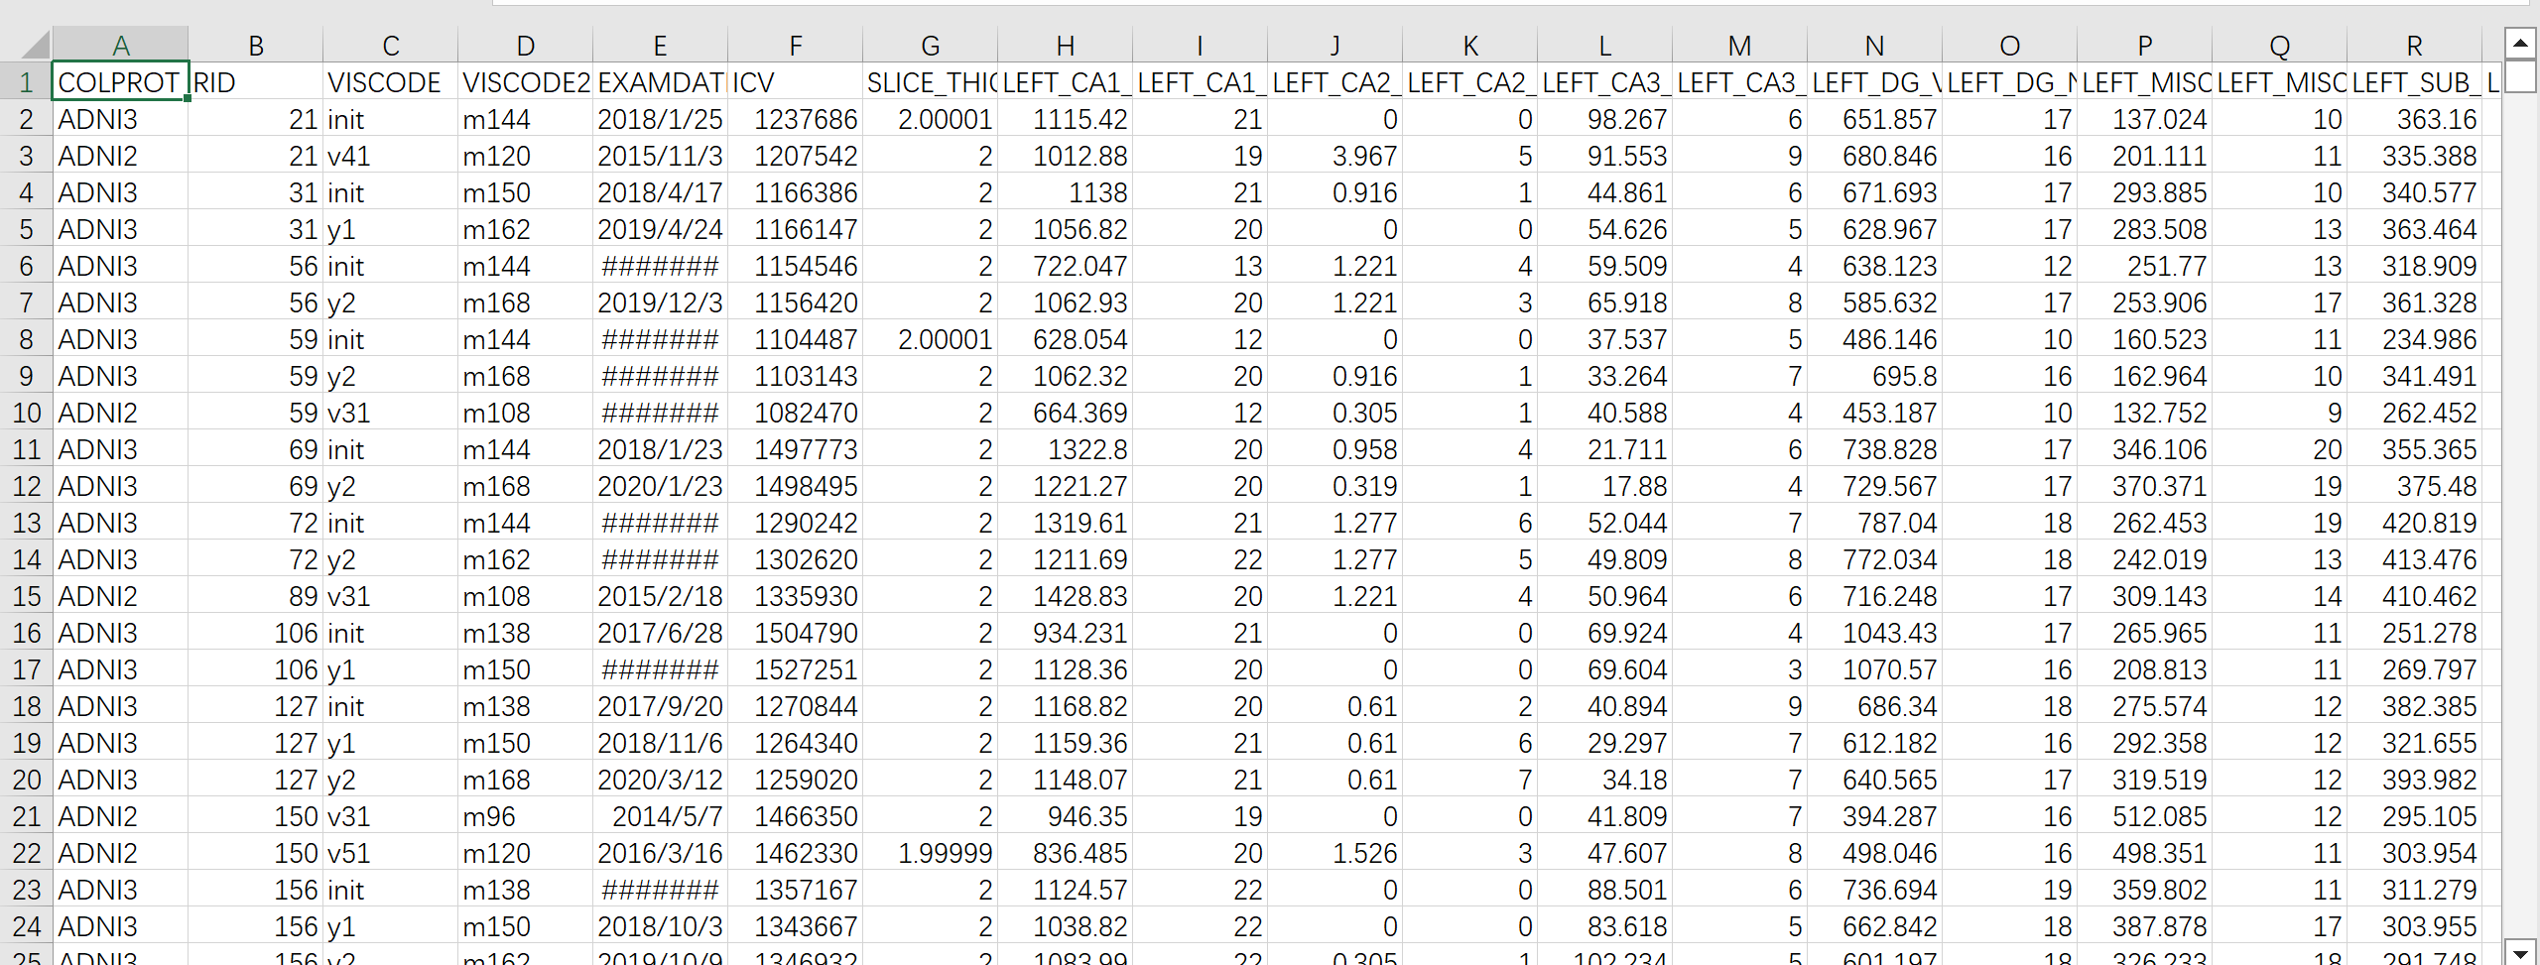
ADNI_PICSLASHS_02_15_22_14Sep2023

Slide 12
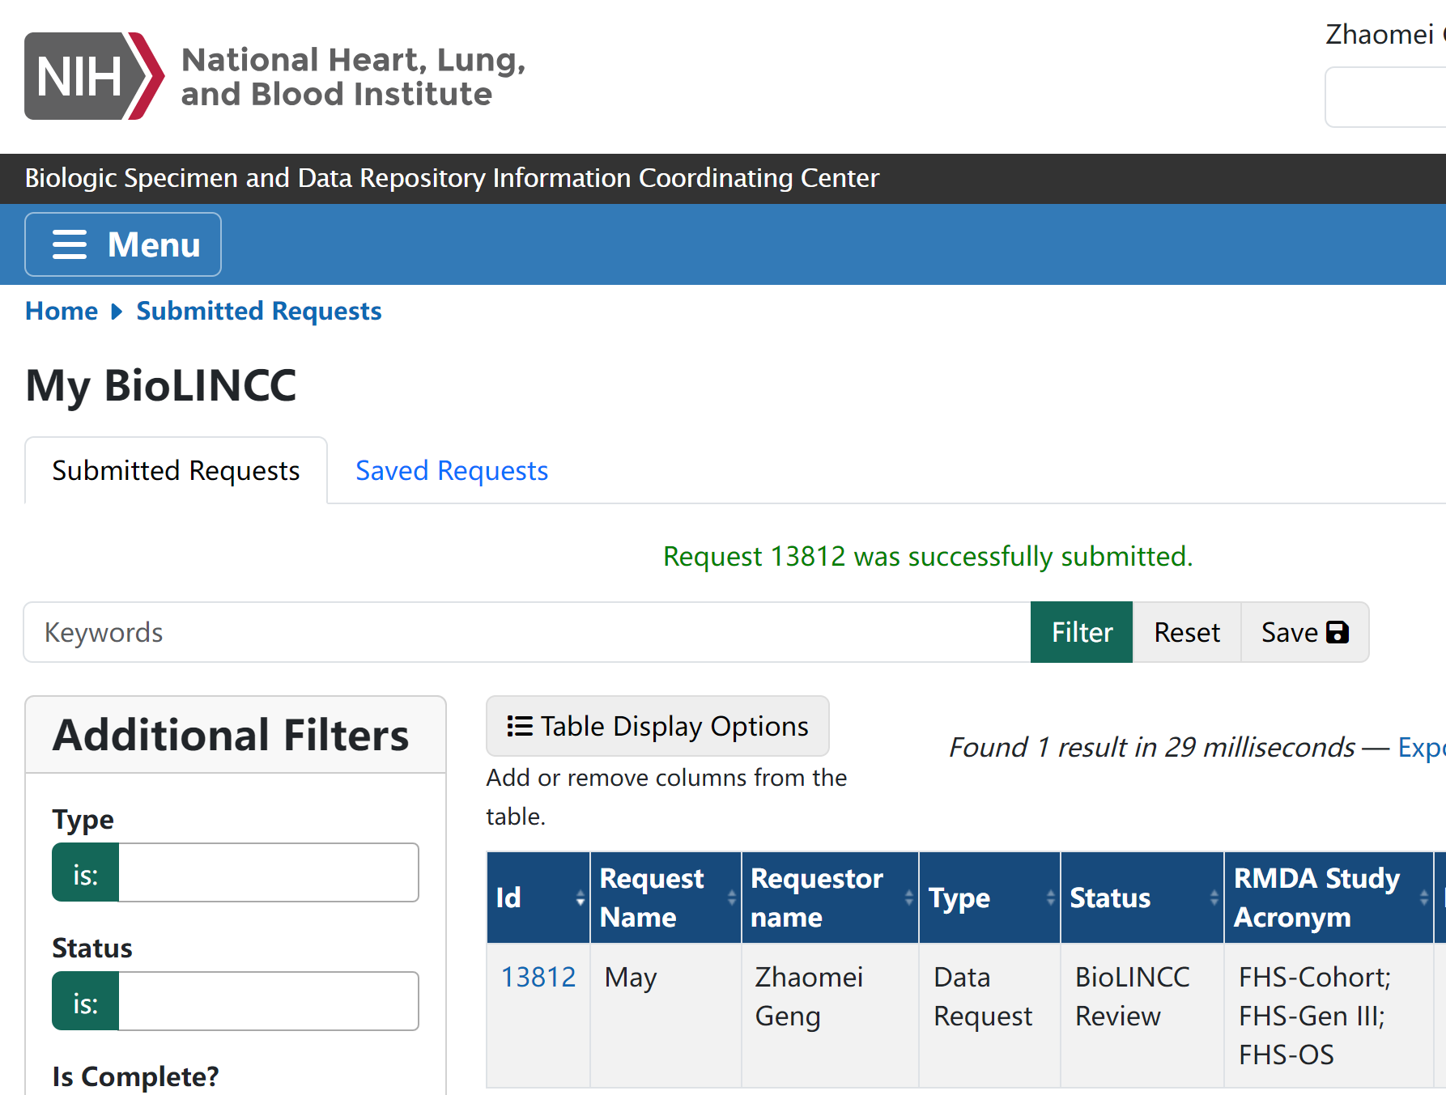
FHS

Slide 13
LBDSU
in-house data

Slide 14
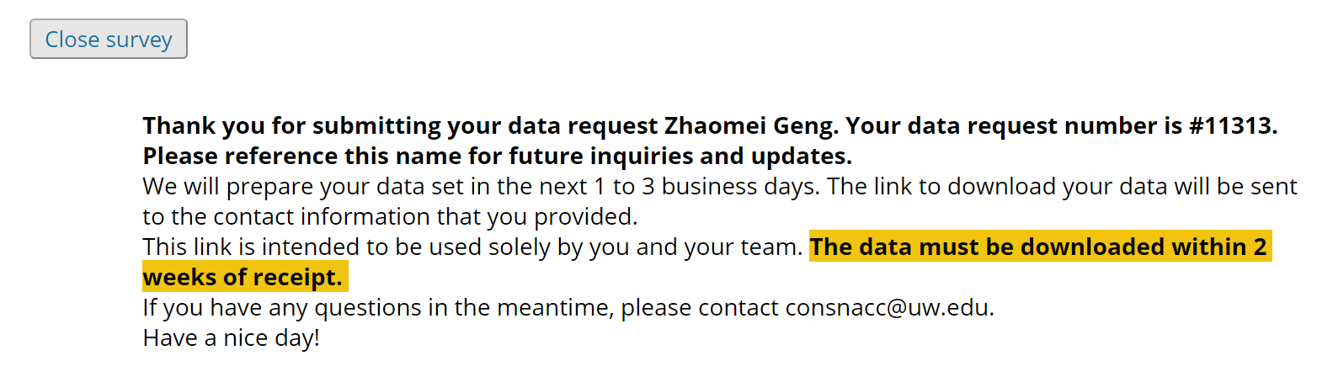
NACC

Slide 15
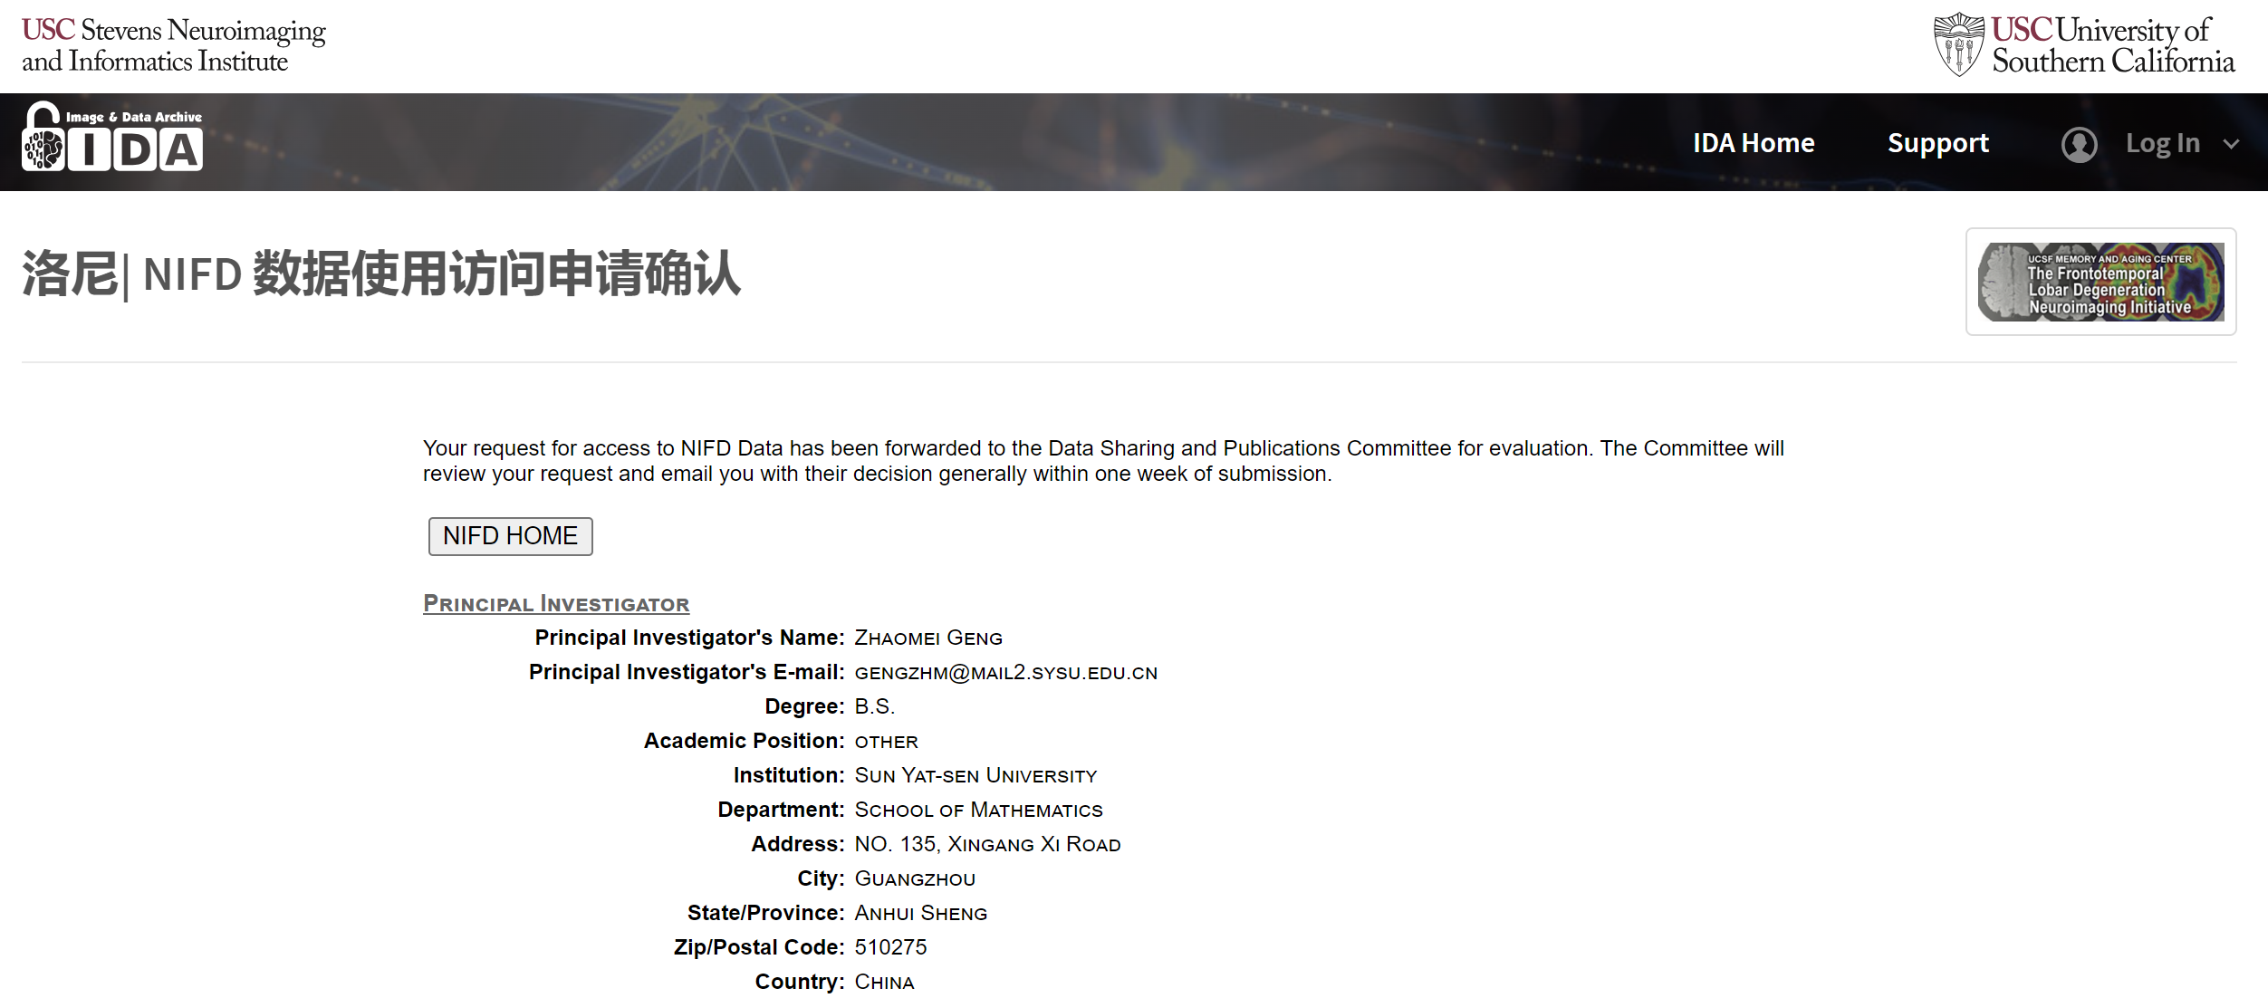
NIFD

Slide 16
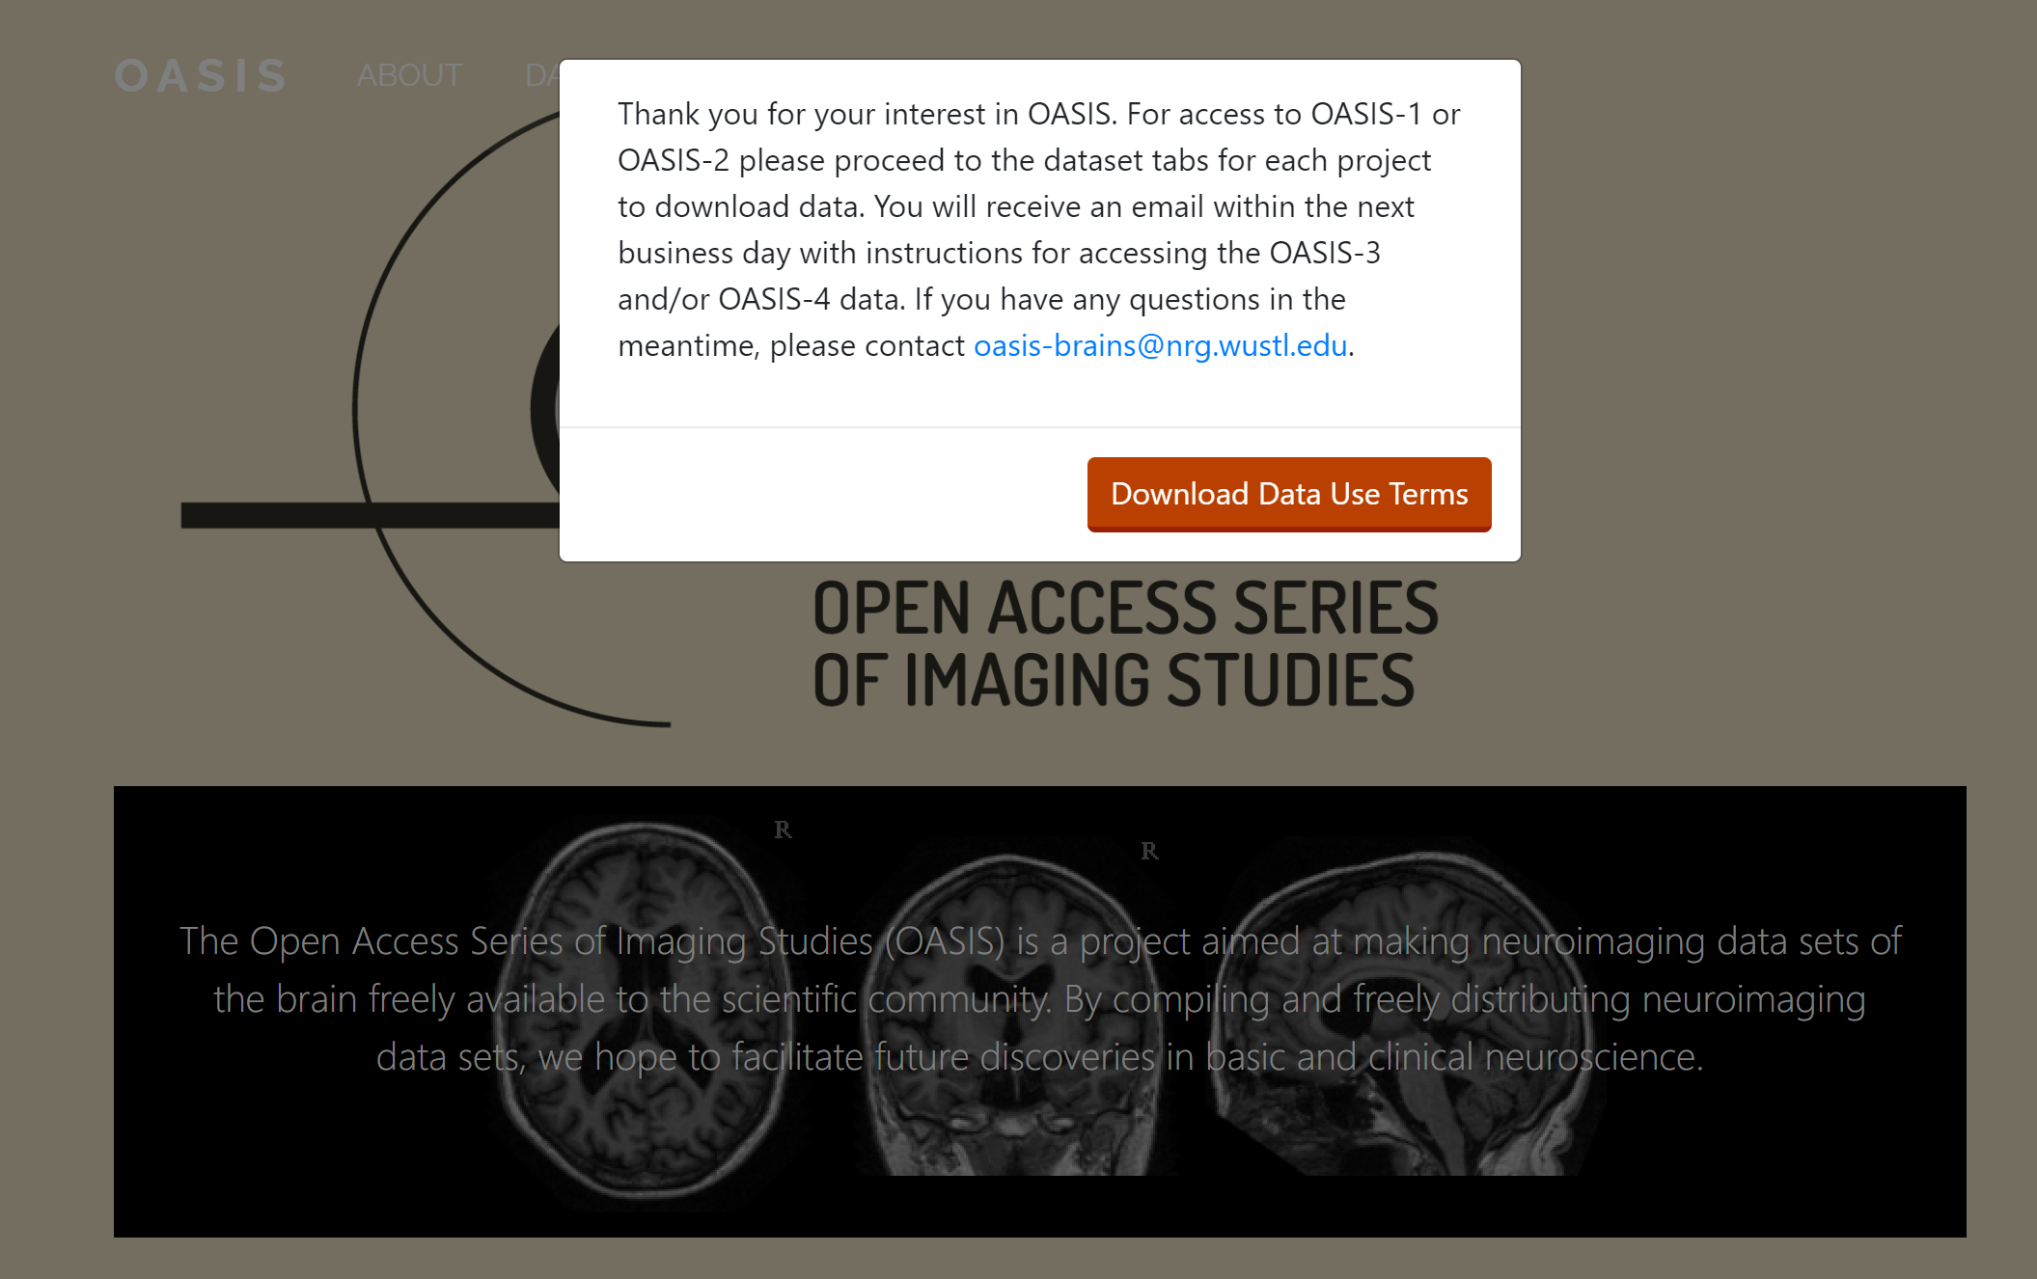
OASIS

Slide 17
OASIS-1: Cross-sectional MRI Data in Young, Middle Aged, Nondemented and Demented Older Adults
Subjects: 416
MR Sessions: 434
This set consists of a cross-sectional collection of 416 subjects aged 18 to 96. For each subject, 3 or 4 individual T1-weighted MRI scans obtained in single scan sessions are included. The subjects are all right-handed and include both men and women. 100 of the included subjects over the age of 60 have been clinically diagnosed with very mild to moderate Alzheimer’s disease (AD). Additionally, a reliability data set is included containing 20 nondemented subjects imaged on a subsequent visit within 90 days of their initial session.

Slide 18
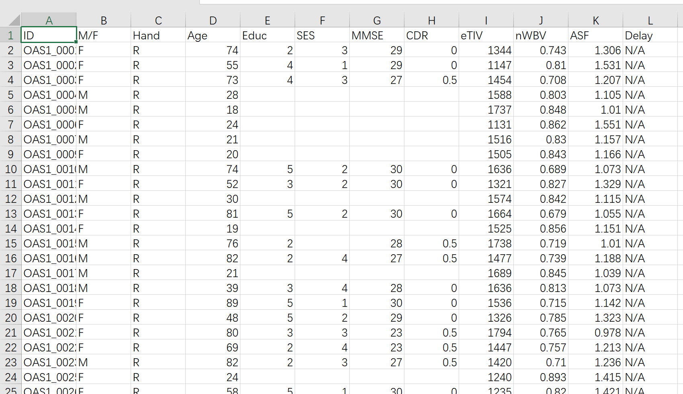

Slide 19
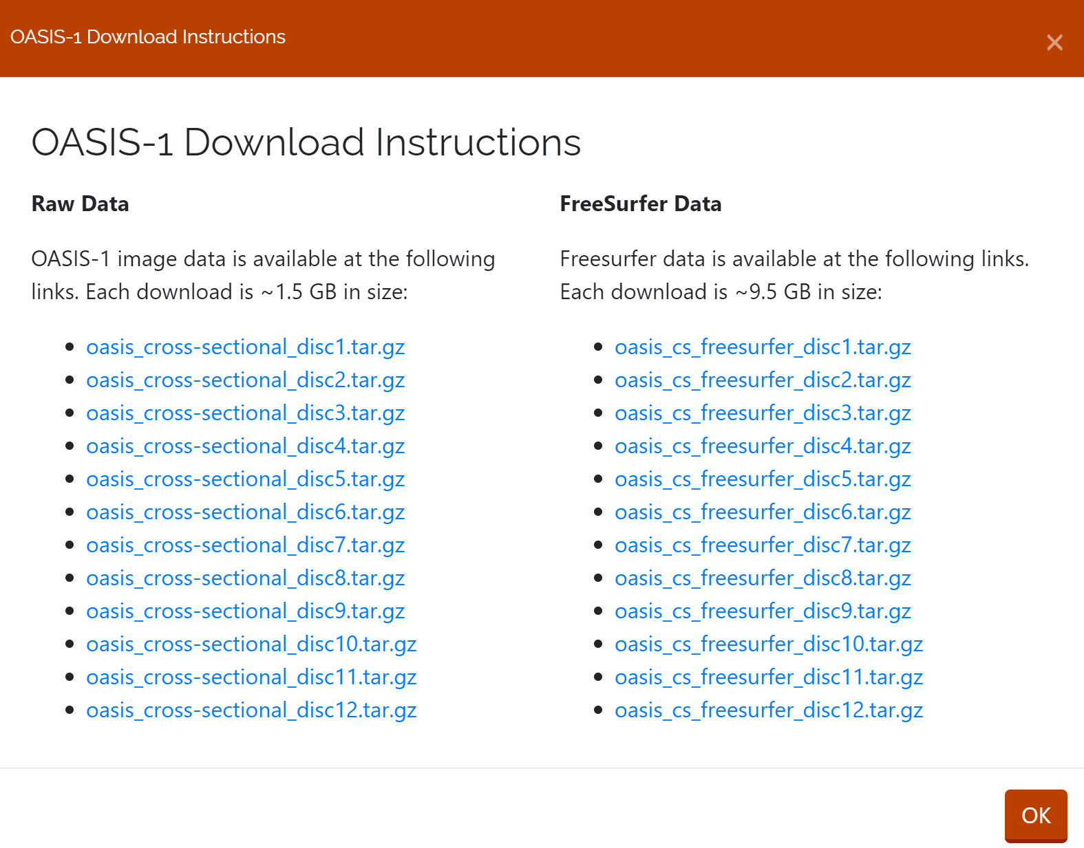

Slide 20
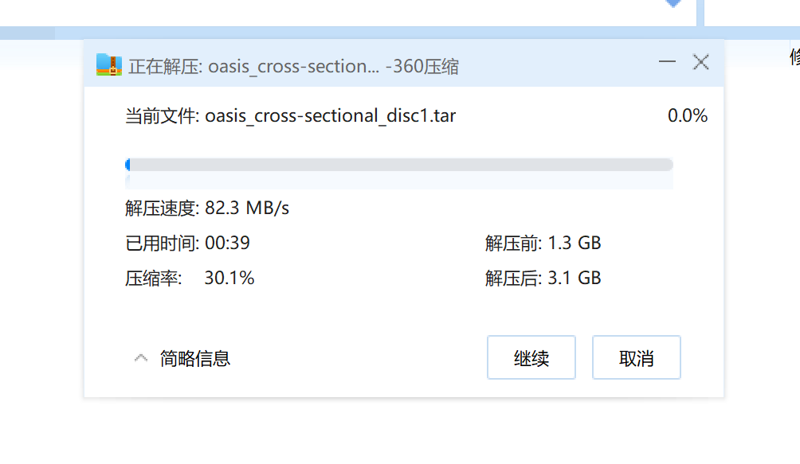

Slide 21
OASIS-2: Longitudinal MRI Data in Nondemented and Demented Older Adults
Subjects: 150
MR Sessions: 373
Summary: This set consists of a longitudinal collection of 150 subjects aged 60 to 96. Each subject was scanned on two or more visits, separated by at least one year for a total of 373 imaging sessions. For each subject, 3 or 4 individual T1-weighted MRI scans obtained in single scan sessions are included. The subjects are all right-handed and include both men and women. 72 of the subjects were characterized as nondemented throughout the study. 64 of the included subjects were characterized as demented at the time of their initial visits and remained so for subsequent scans, including 51 individuals with mild to moderate Alzheimer’s disease. Another 14 subjects were characterized as nondemented at the time of their initial visit and were subsequently characterized as demented at a later visit.

Slide 22
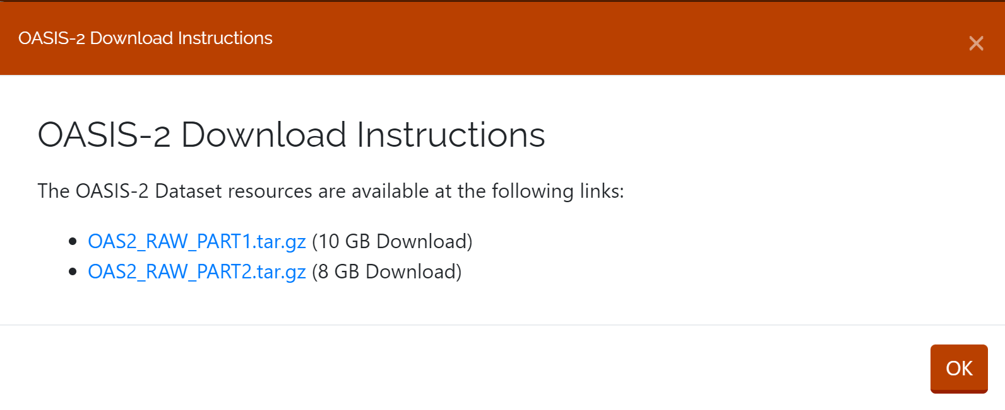

Slide 23
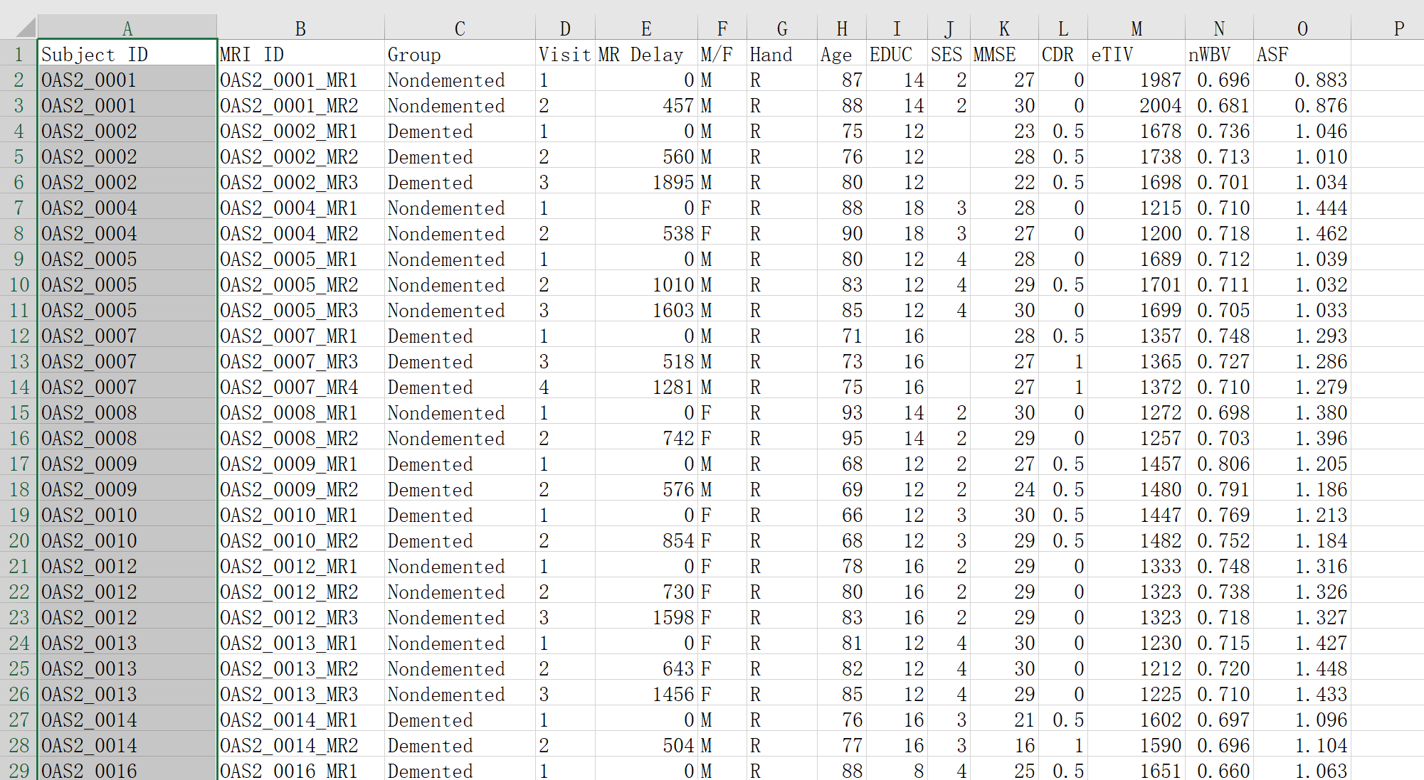

Slide 24
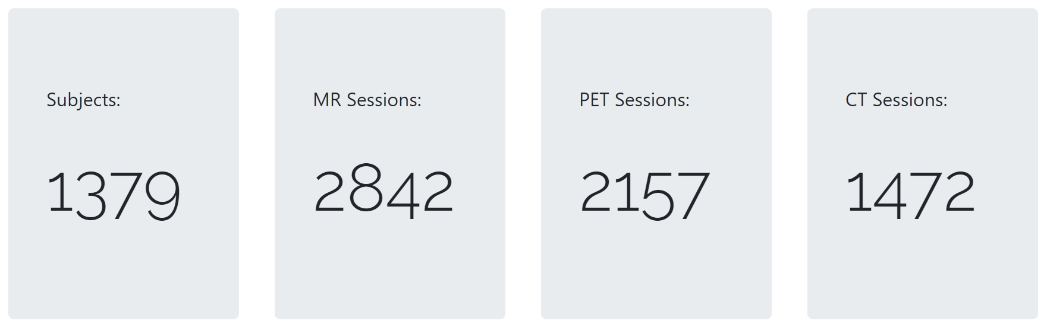
OASIS-3: Longitudinal Multimodal Neuroimaging, Clinical, and Cognitive Dataset for Normal Aging and Alzheimer’s Disease

Slide 25
OASIS-4: Clinical Cohort
Subjects: 663
MR Sessions: 676
This set consists of a collection of 663 subjects aged 21 to 94. This clinical cohort was evaluated for memory disorders and dementia including clinical, csf, neurospychometric, and neuroimaging assessments. This is a unique dataset and not an update to the OASIS-3 Longitudinal Multimodal Neuroimaging dataset.

Slide 26
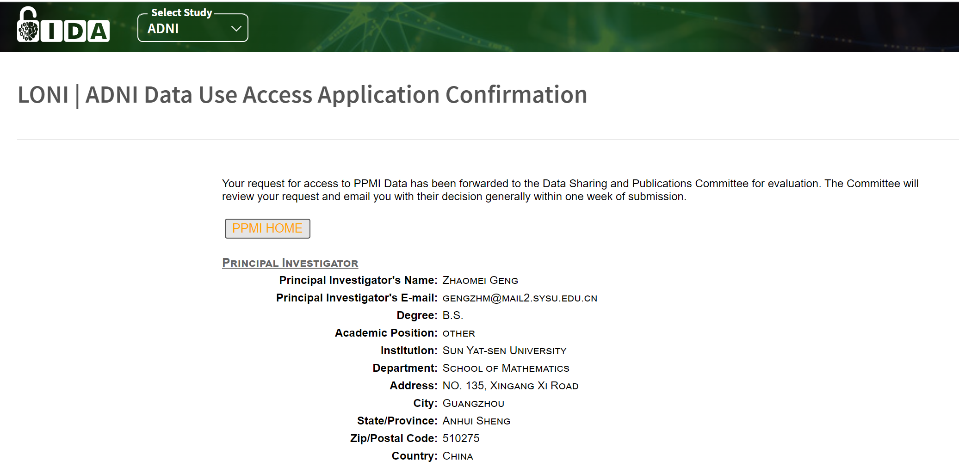
PPMI

